Slide 1

Do Badges Effect Innovation Efforts on GitHub
Tim Toth
Eco 590

Slide 2
Motivations
Today, over 90% of all Fortune-500 companies use open source products (Github, 2022)
At the same time, monetary incentives might crowd out intrinsic motivation (Bénabou and Tirole, 2003)
In tandem with the rise in importance of open source for machine learning, we have also come to observe a decline in the value of information technology (IT) patents.(Acikalin, U.U, Caskurlu, 2022)

Slide 3
Research Questions
Estimate the impact of a user having an achievement on open-source innovation
Asses the relationship b/w receiving their first achievement and creating new repositories

Slide 4
Key Variables
Repositories
Commits
Issues
achievement

Slide 5
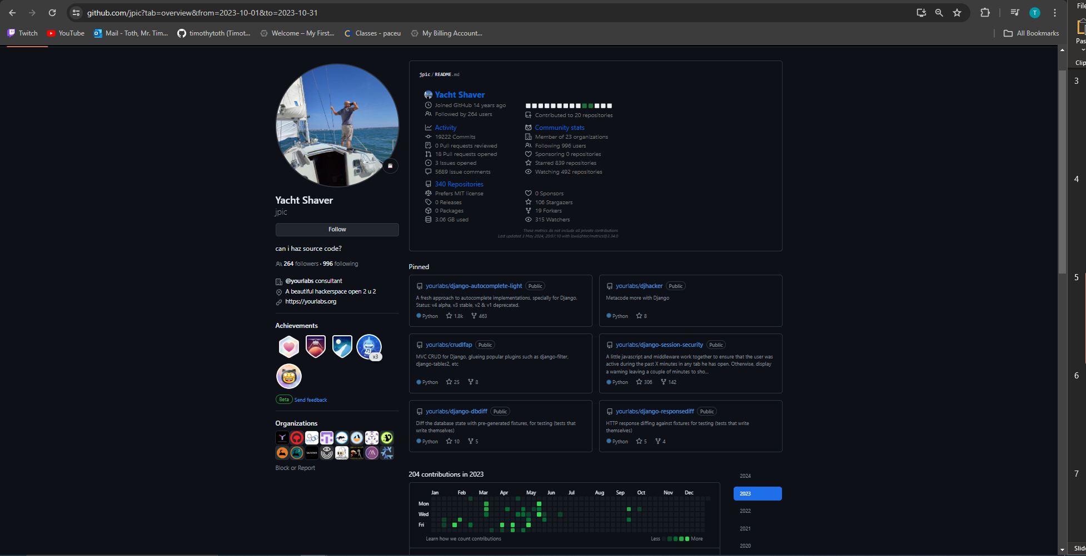
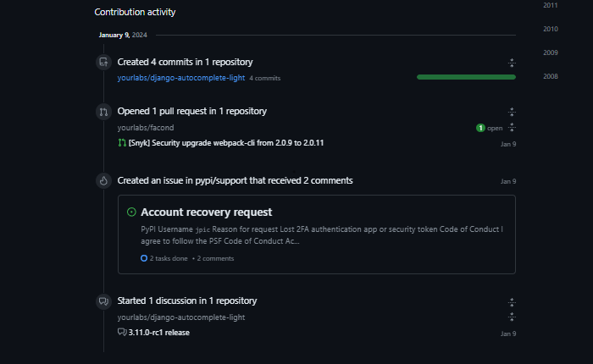
Data Gathering from bigquery

Slide 6
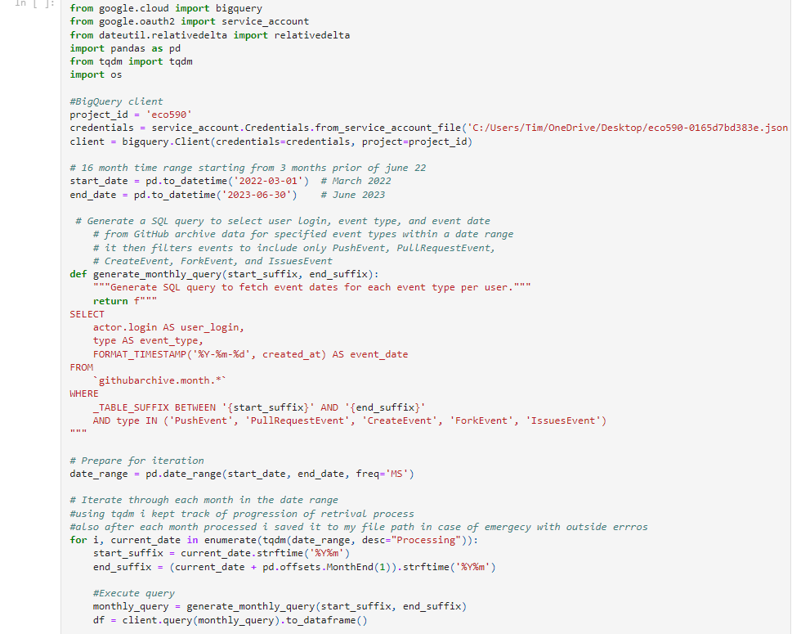
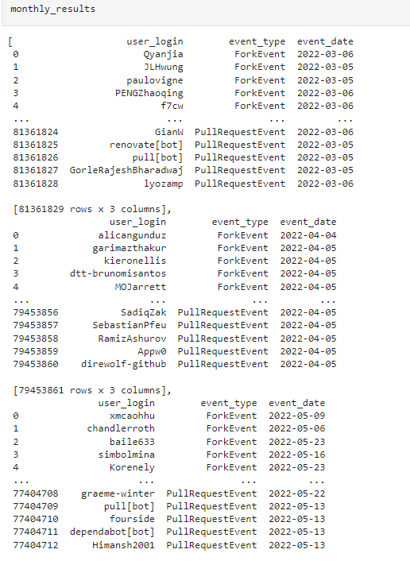
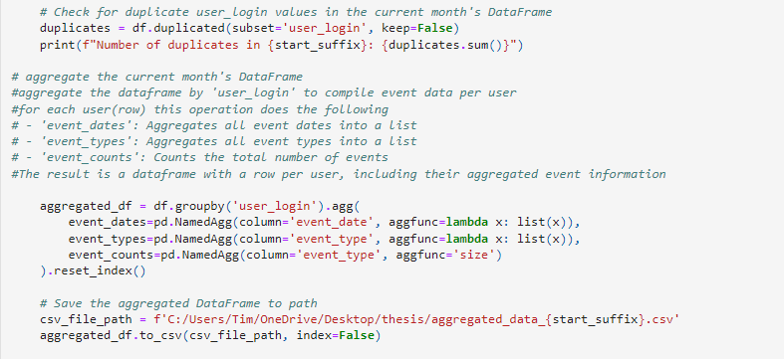
Data Gathering from bigquery

Slide 7
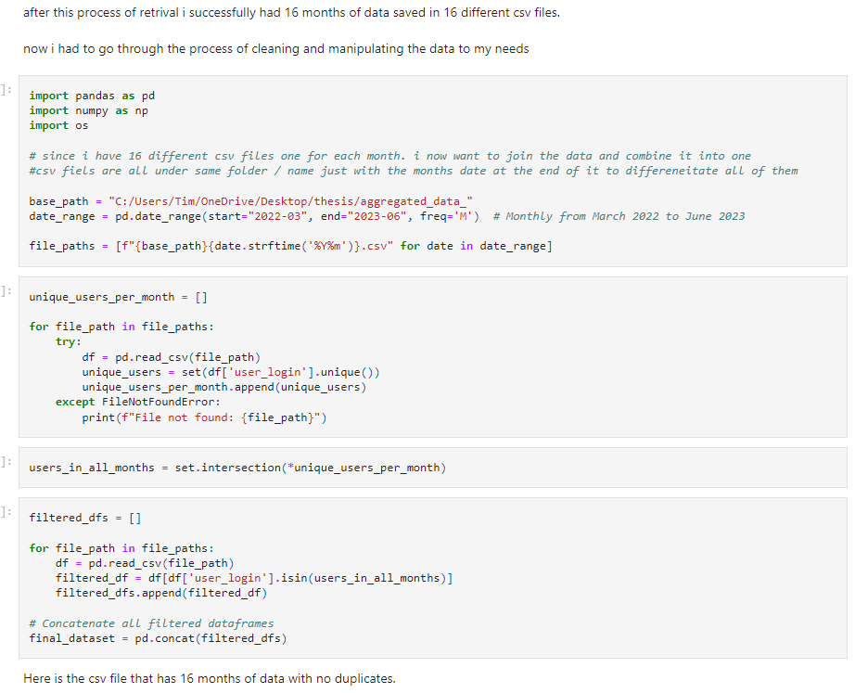
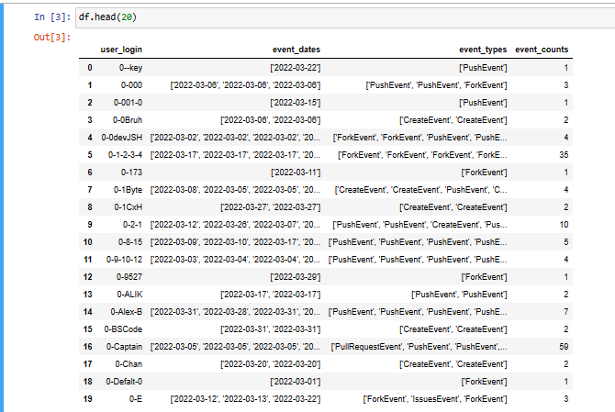

Slide 8
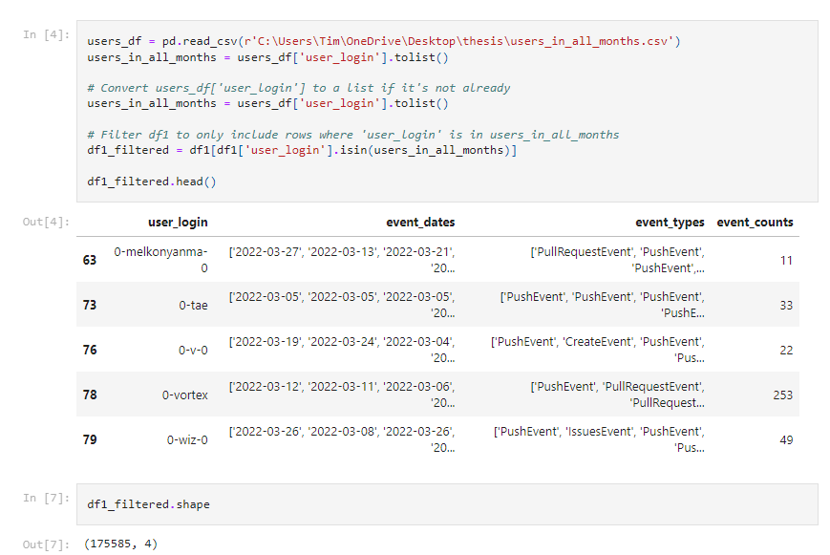
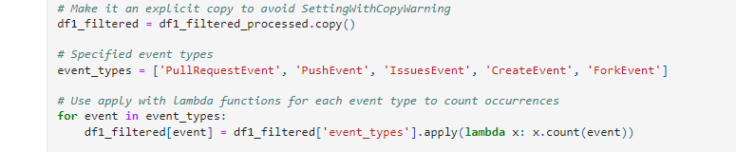
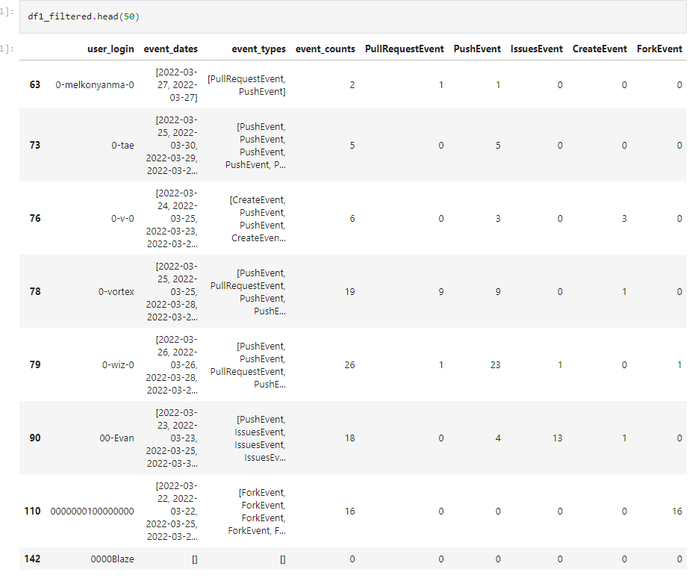
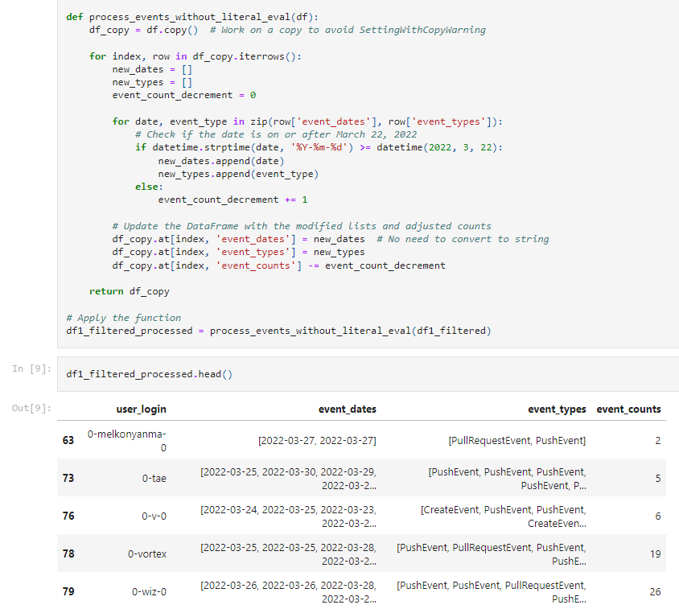

Slide 9
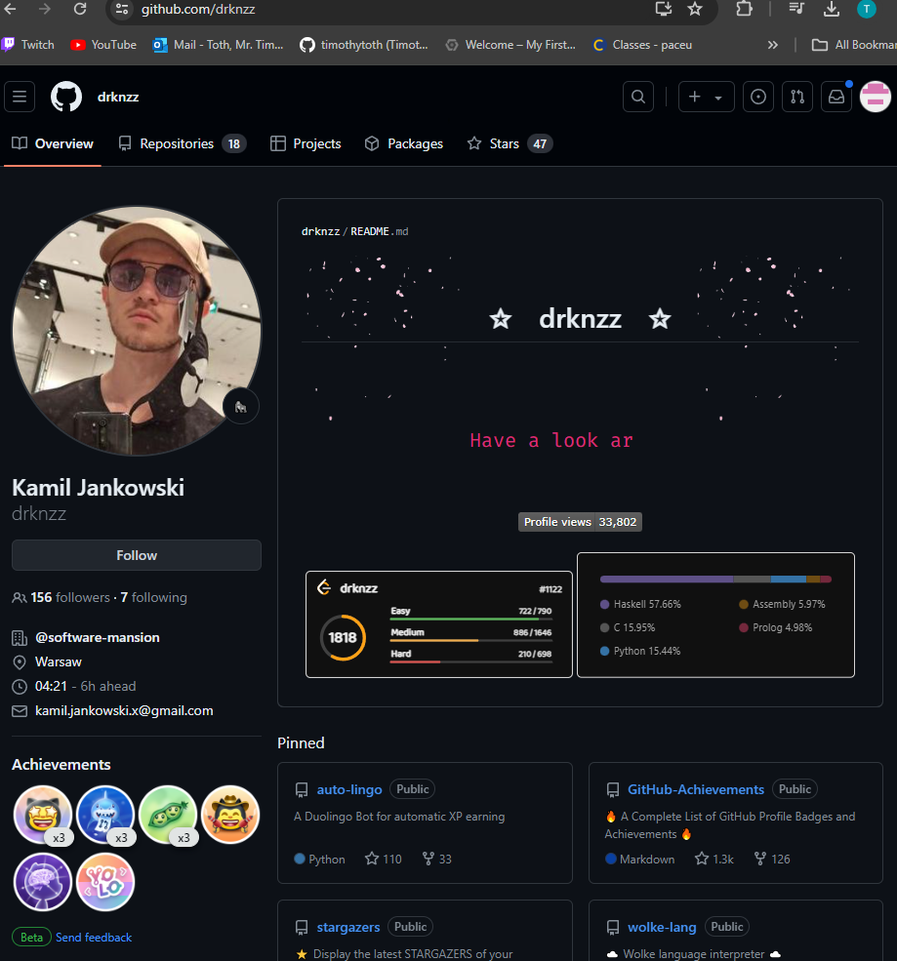
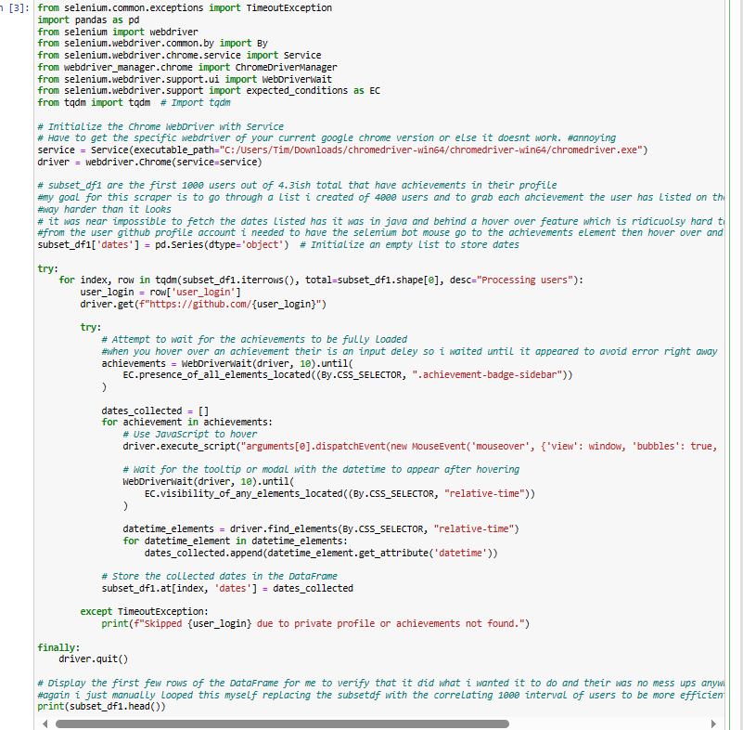
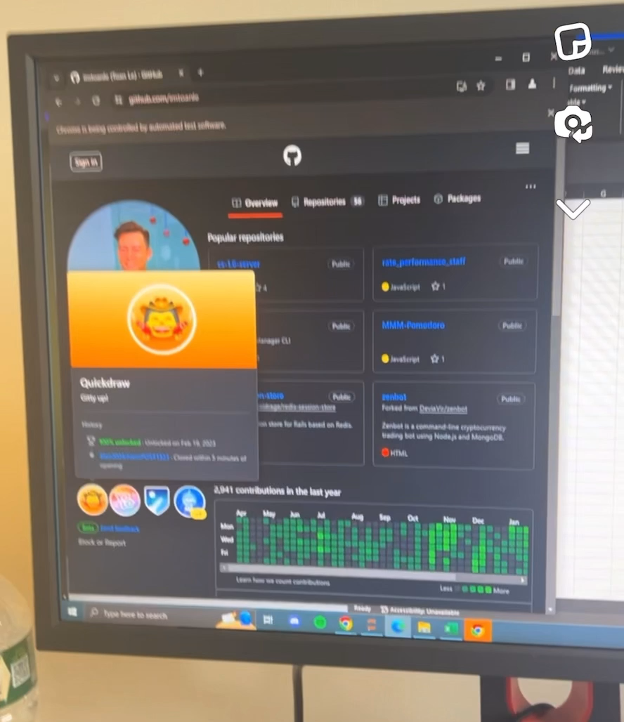
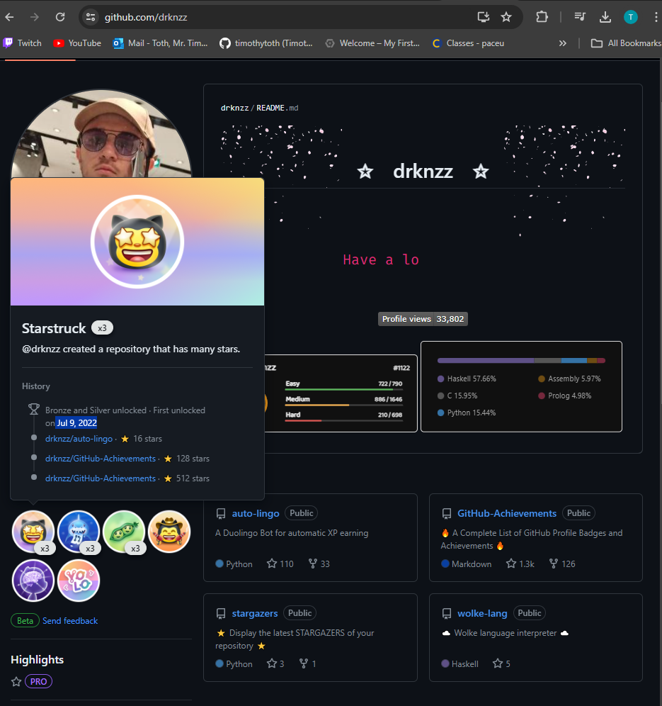
webscraper
<relative-time datetime="2022-07-09T16:14:12Z" month="short" day="numeric" threshold="PT0S" title="Jul 9, 2022, 12:14 PM EDT">
2022-07-09 12:14:12 -0400
</relative-time>

Slide 10
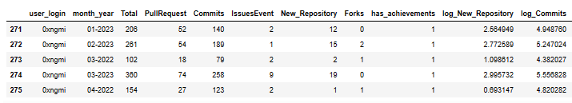
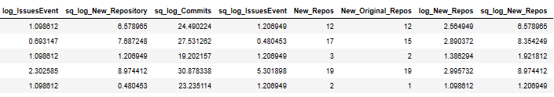
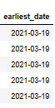
Final dataset

Slide 11
Propensity Score (IPW)
Estimated a probit model, to predict each user's probability p of receiving the treatment given pre time period baseline observational characteristics

Slide 12
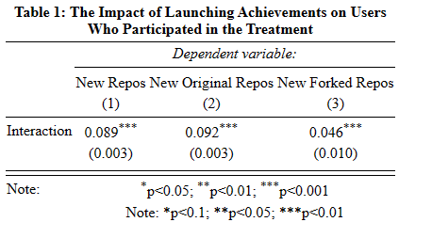
E(Yit|Xit) = γi exp(β · has_achievementi · I[t > June 2022] + τt)

